Slide 1

How to provision FocalpointK12 users
Notes:
In this video we would be seeing how to add a new school, provision school admins , teachers and students and associate them to course sections.

Slide 2
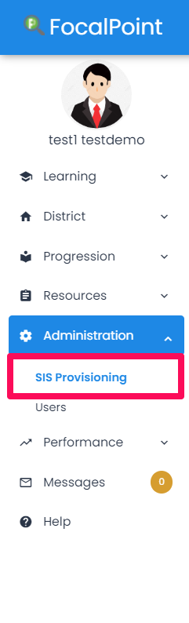
Provisioning Menu
Notes:
District Admins would select Provisioning from the Administration menu on the left side of the Focalpoint login page .

Slide 3
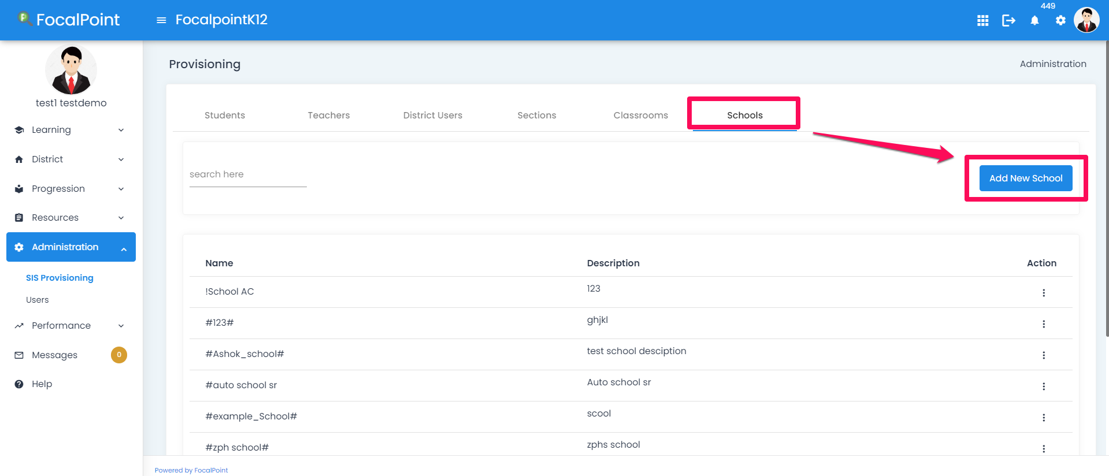
How to add a new school?
Notes:
Let's take a look on to how to add a school . District admins can add a new school by clicking Add New button as shown in the figure.

Slide 4
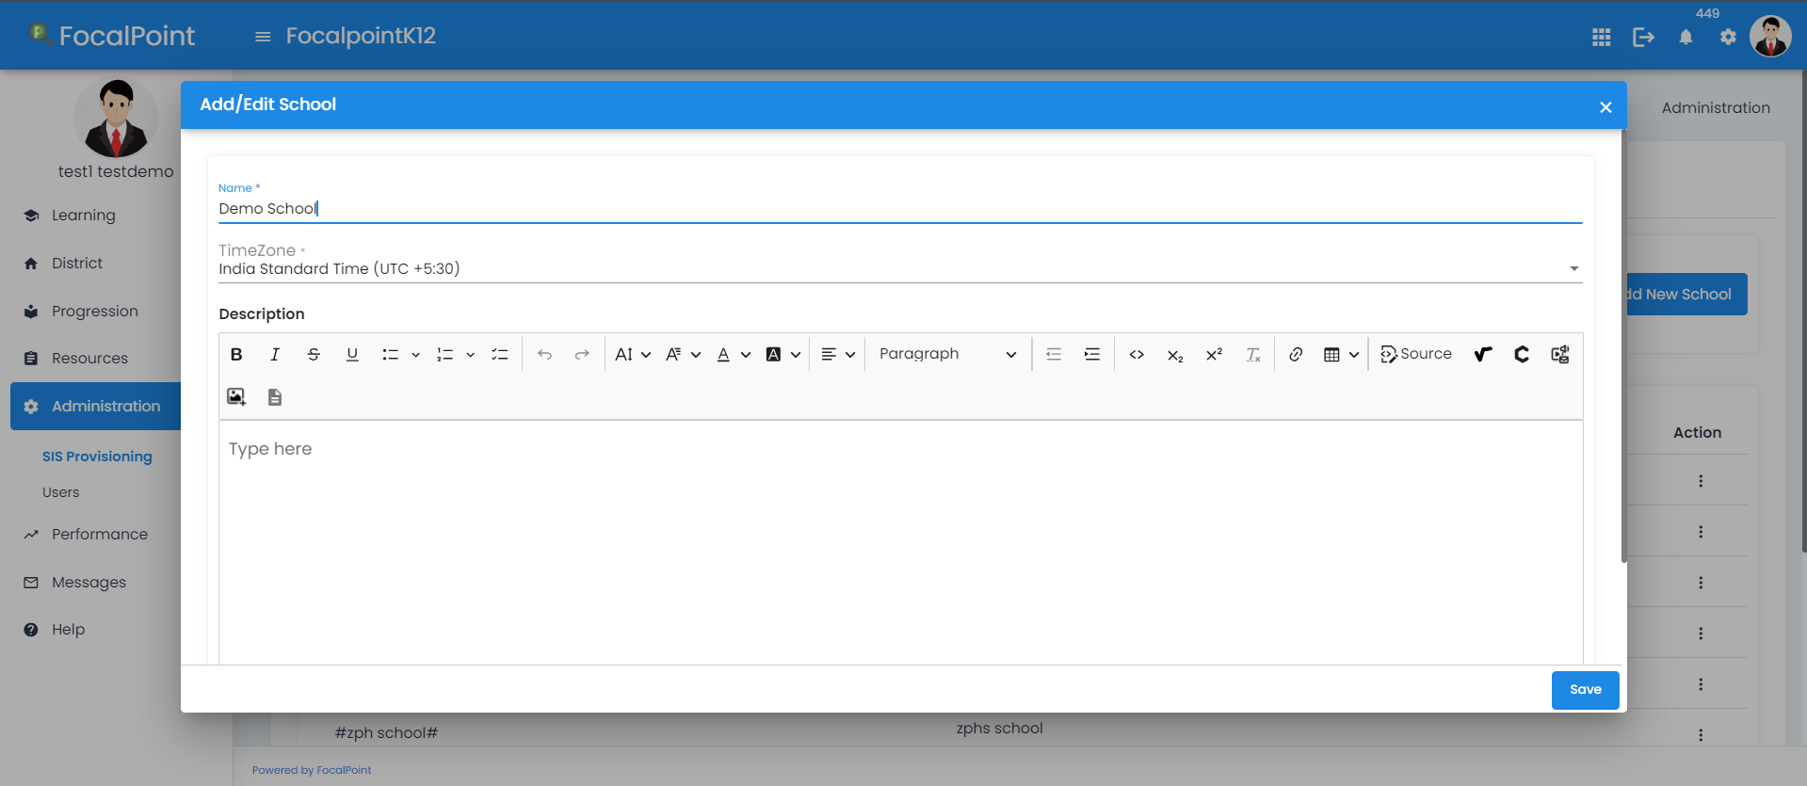
New School Details
Notes:
They would then enter the Name, Description and hit save button. This would save the school details and the other users can be added or associated to this school.
We can now setup the Classrooms and Course sections for this school.

Slide 5
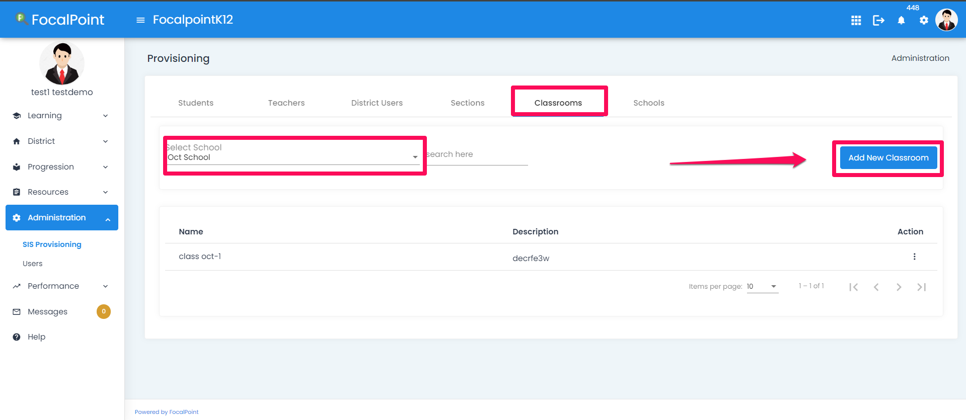
How to add a Classroom to the school?
Notes:
Let's take a look on how to add a classroom to a school . We will first select the school and then select Add New to create a classroom.

Slide 6
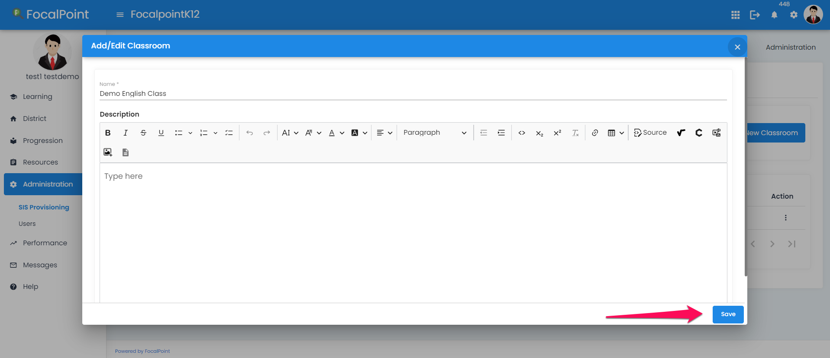
New Classroom Details
Notes:
We then Add the Classroom information and hit Save button.

Slide 7
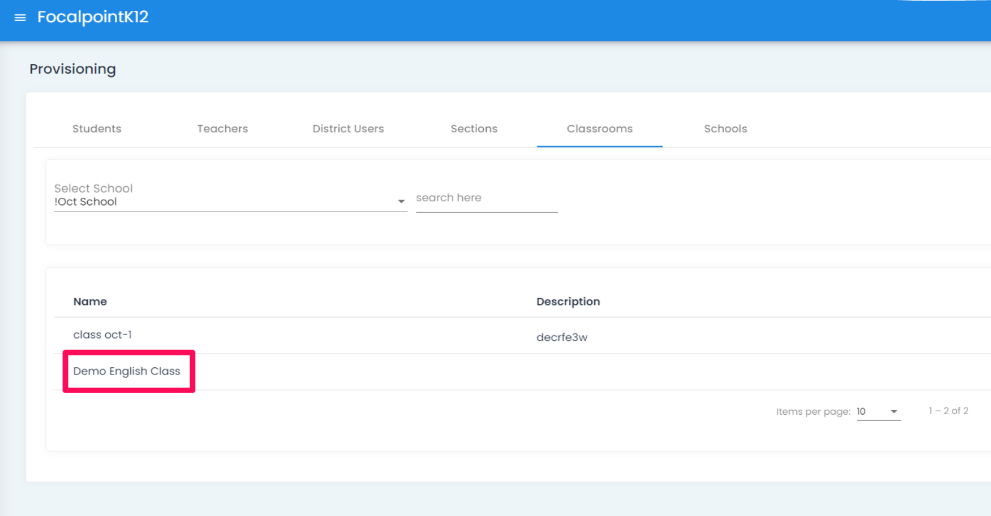
Classroom has been added
Notes:
We then Add the Classroom information and hit Save button.

Slide 8
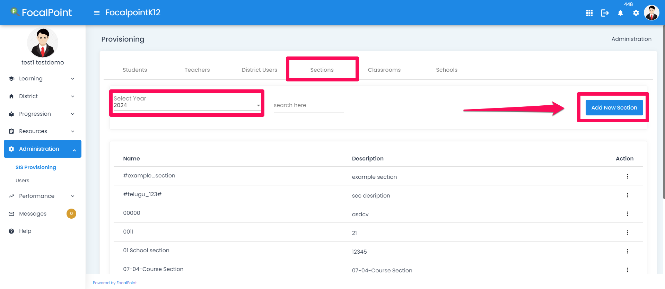
How to add Courses
Notes:
We first add the courses and then associate them to each individual classroom .Now, lets take a look on how to add these courses . As shown here, the district admins would be selecting Section from SIS Provisioning menu.
We click the Add new Section on the right side of the screen here and enter the details.

Slide 9
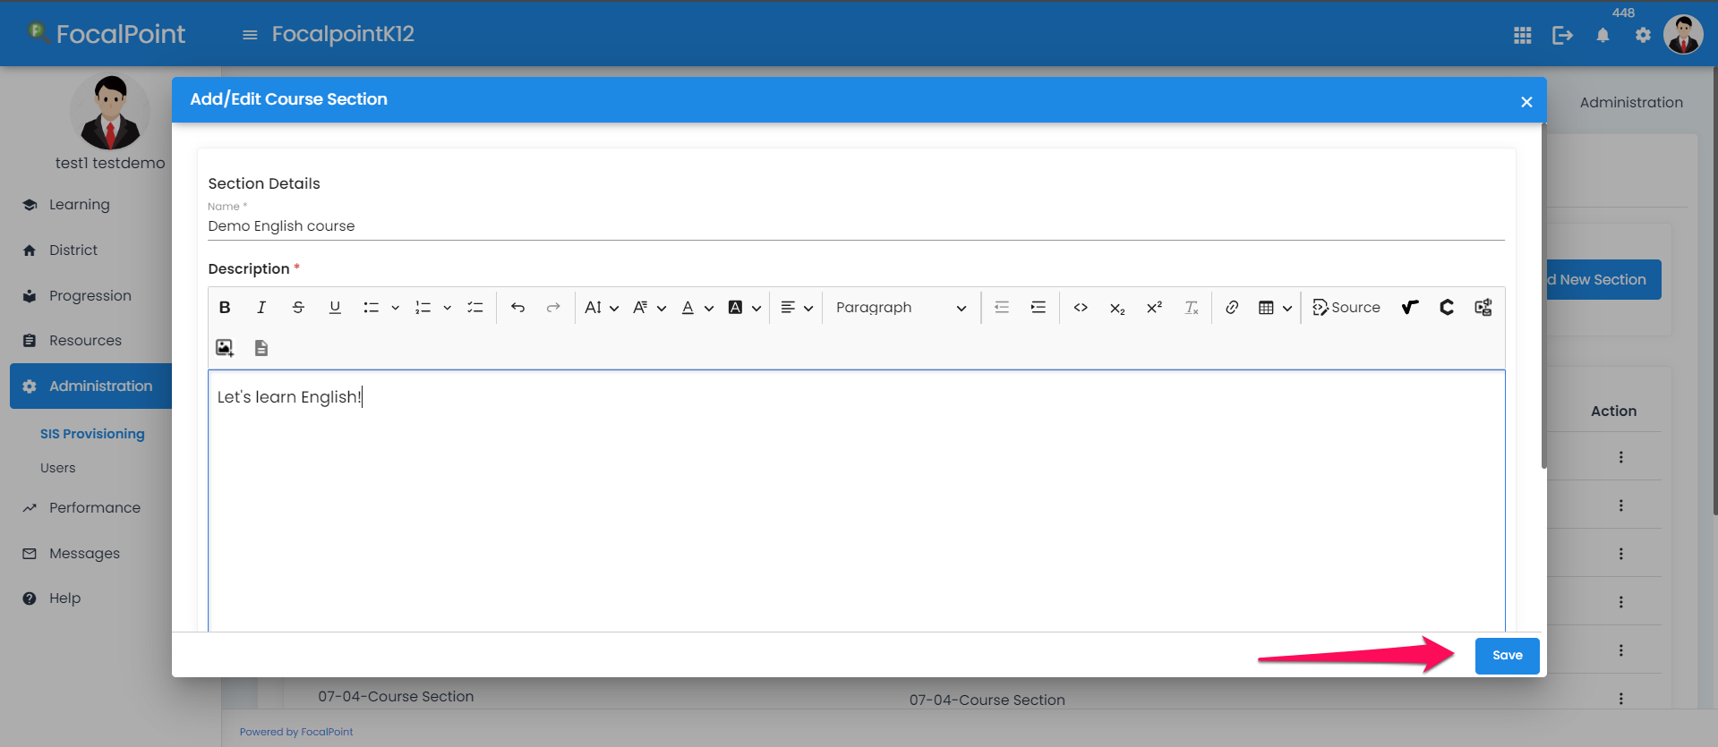
Add new Course
Notes:
Here we provide the details like Name, Description and Rubrics. Click on save. This course will now be added to list of courses.

Slide 10
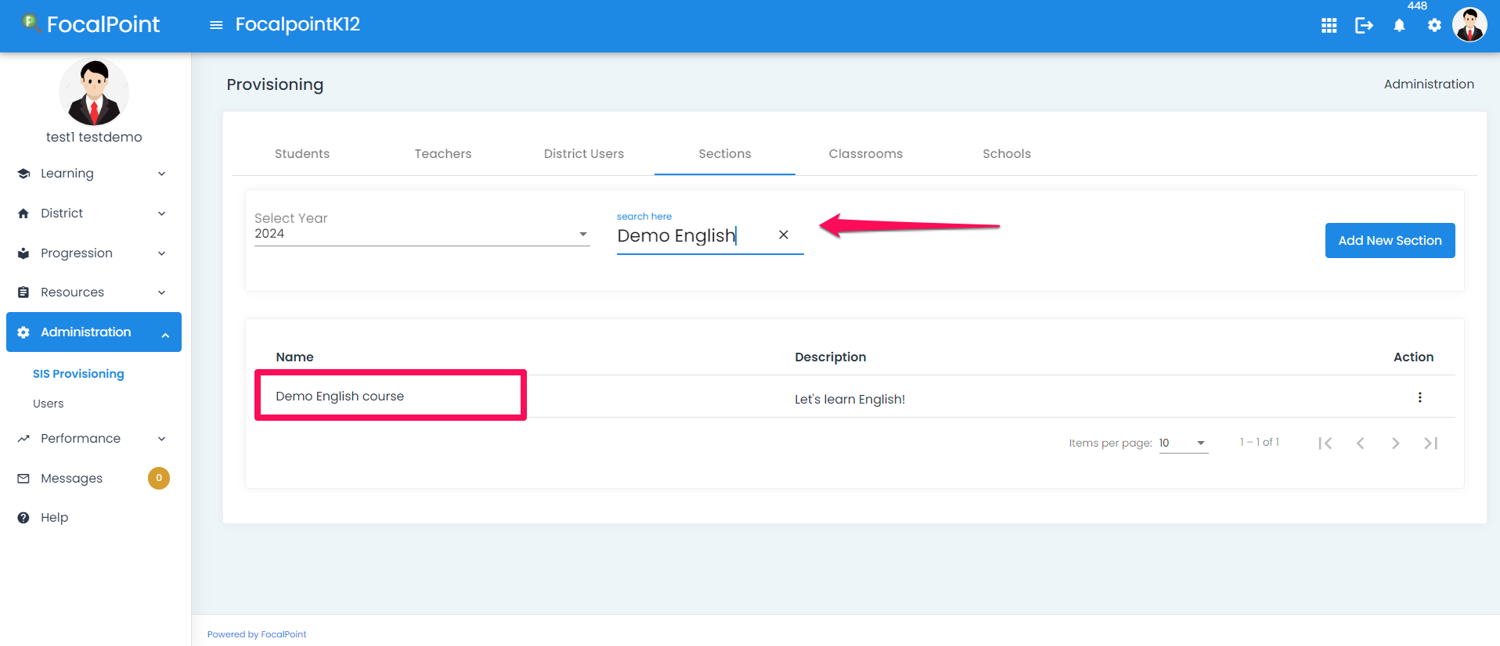
Search the course
Notes:
We can search for a course by using the search courses bar on the top.

Slide 11
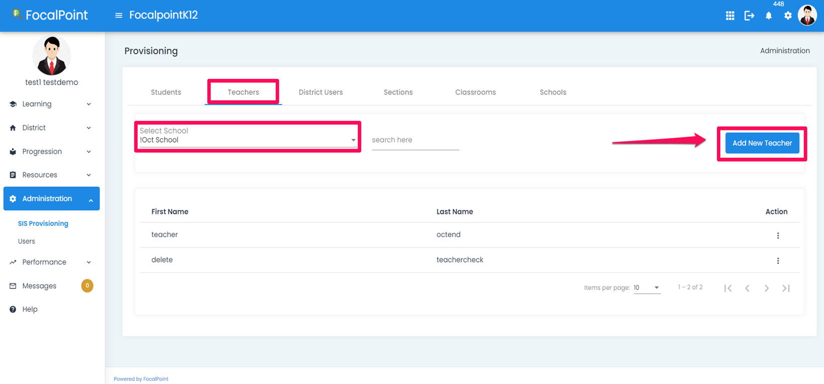
How to add a School administrator/ Teachers
Notes:
We can search for a course by using the search courses bar on the top.

Slide 12
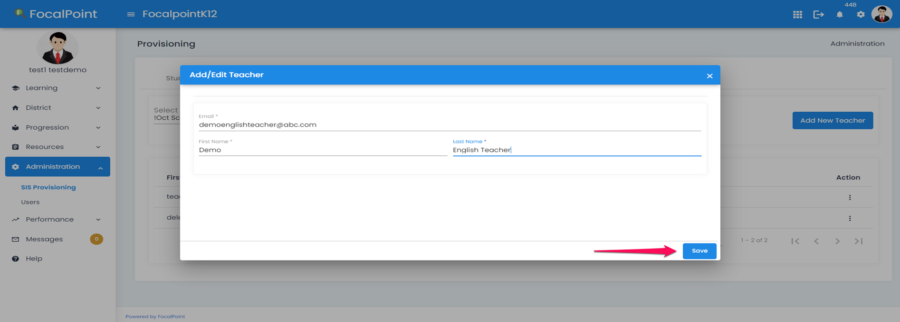
Add details
Notes:
Once the details are added, click on Save

Slide 13
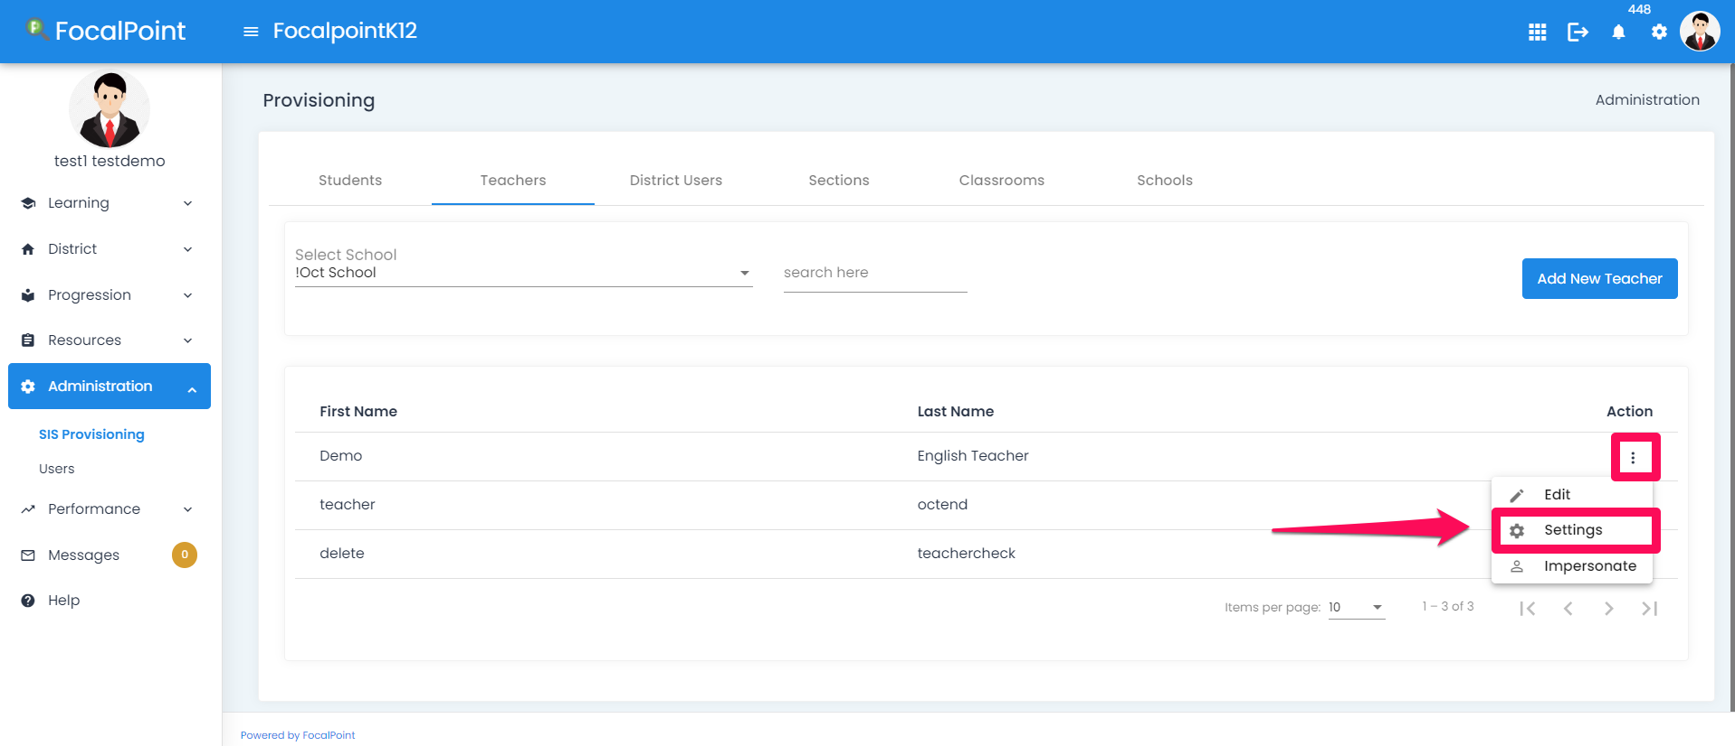
Select School Admin
Notes:
Click on the 3 dots against the newly added user and select Settings.

Slide 14
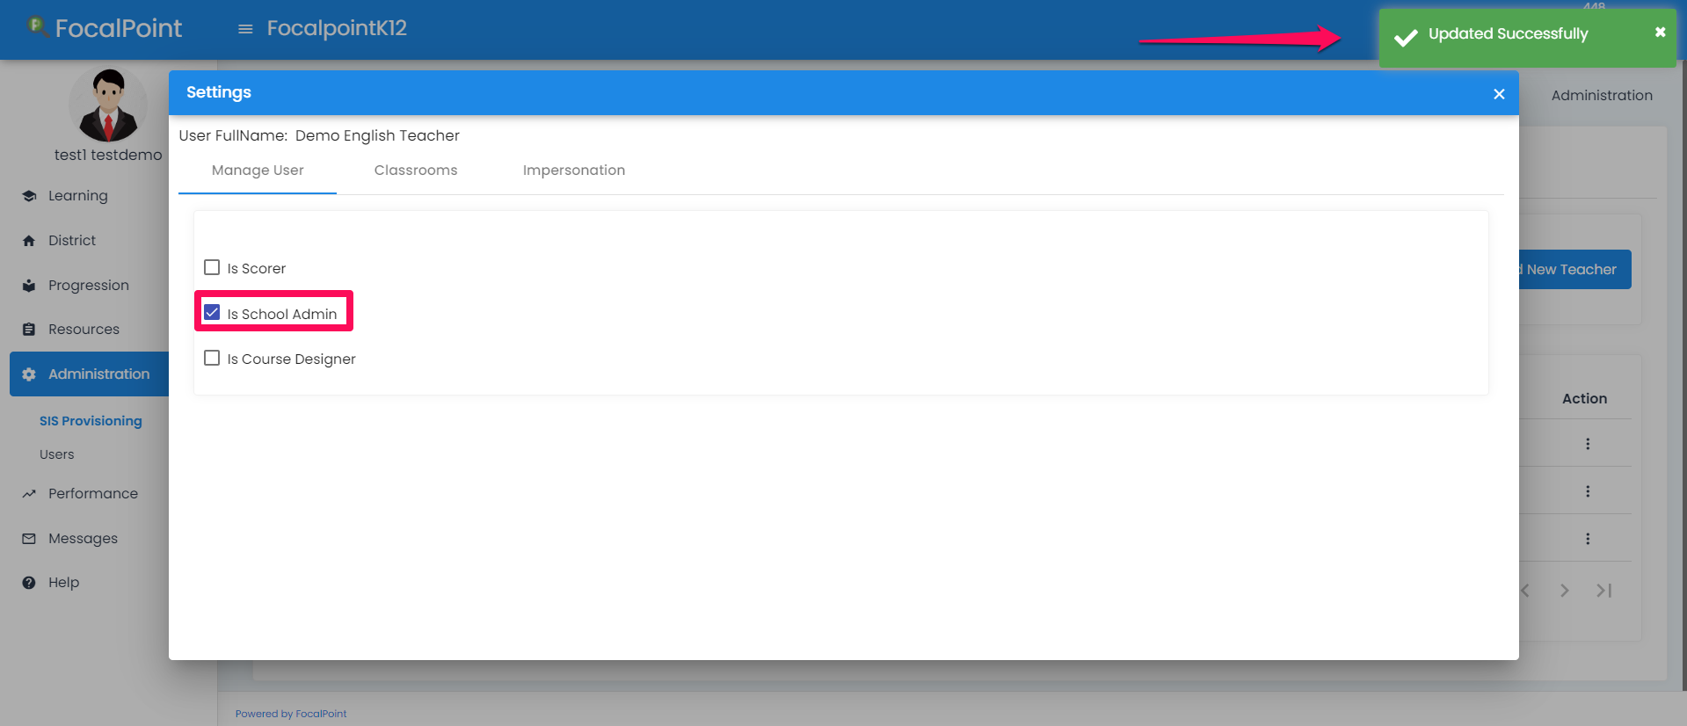
School Admin Updated
Notes:
Select the check box if the user is a School Admin. School Admin will be updated successfully.

Slide 15
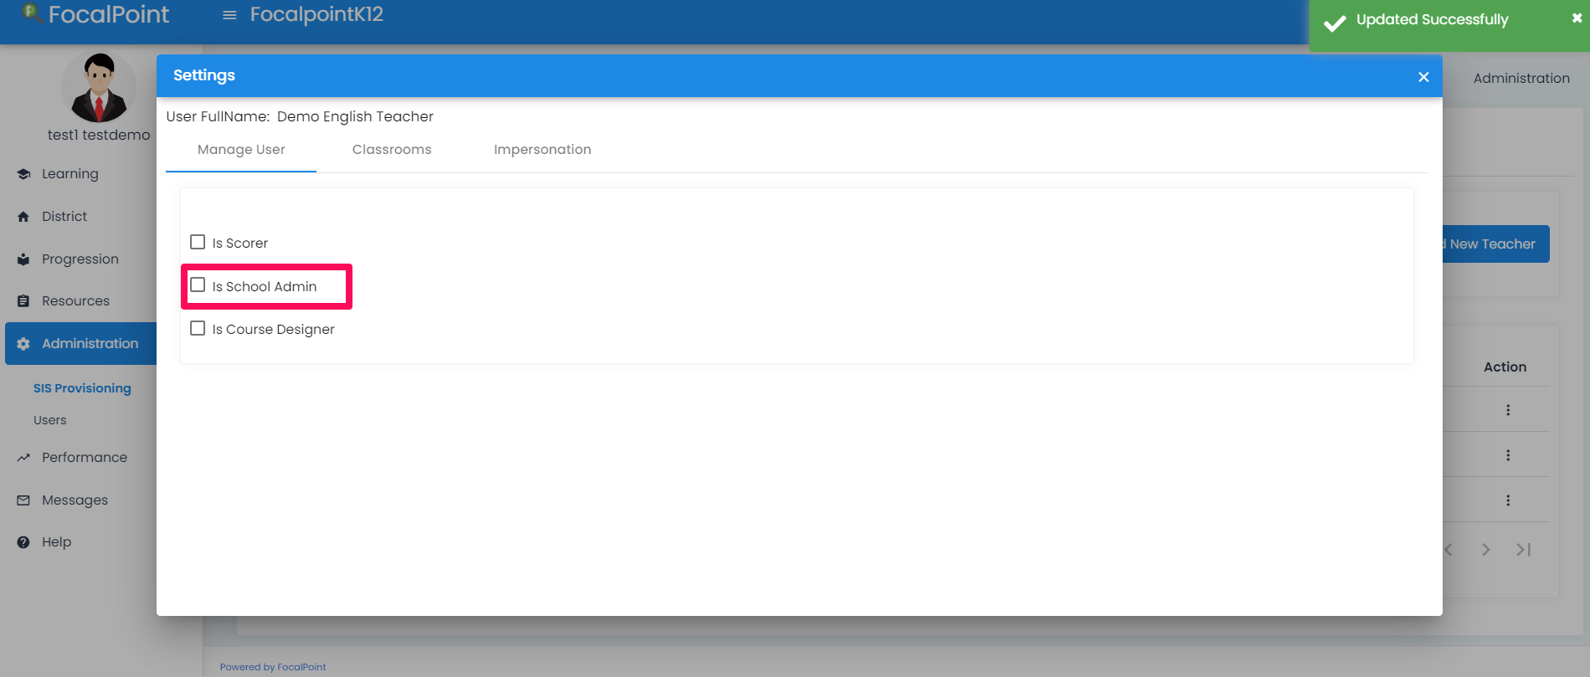
How to add teachers?
Notes:
Now, lets take a look on how to add teachers or school users.
As mentioned before, We add them the way we added school admins, but we don’t check the box beside Is school Admin. We just provide the Firstname, Lastname and email address and then save this information.

Slide 16
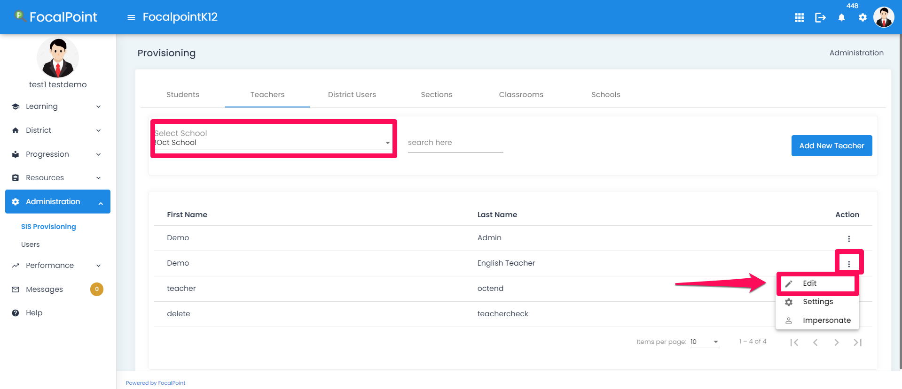
How to setup a FocalpointK12 login?
Notes:
Lets take a look on how to setup FP logins for the admins , teachers or students.
Search for the school, select the User and click on 3 dots under Action
Then select Edit

Slide 17
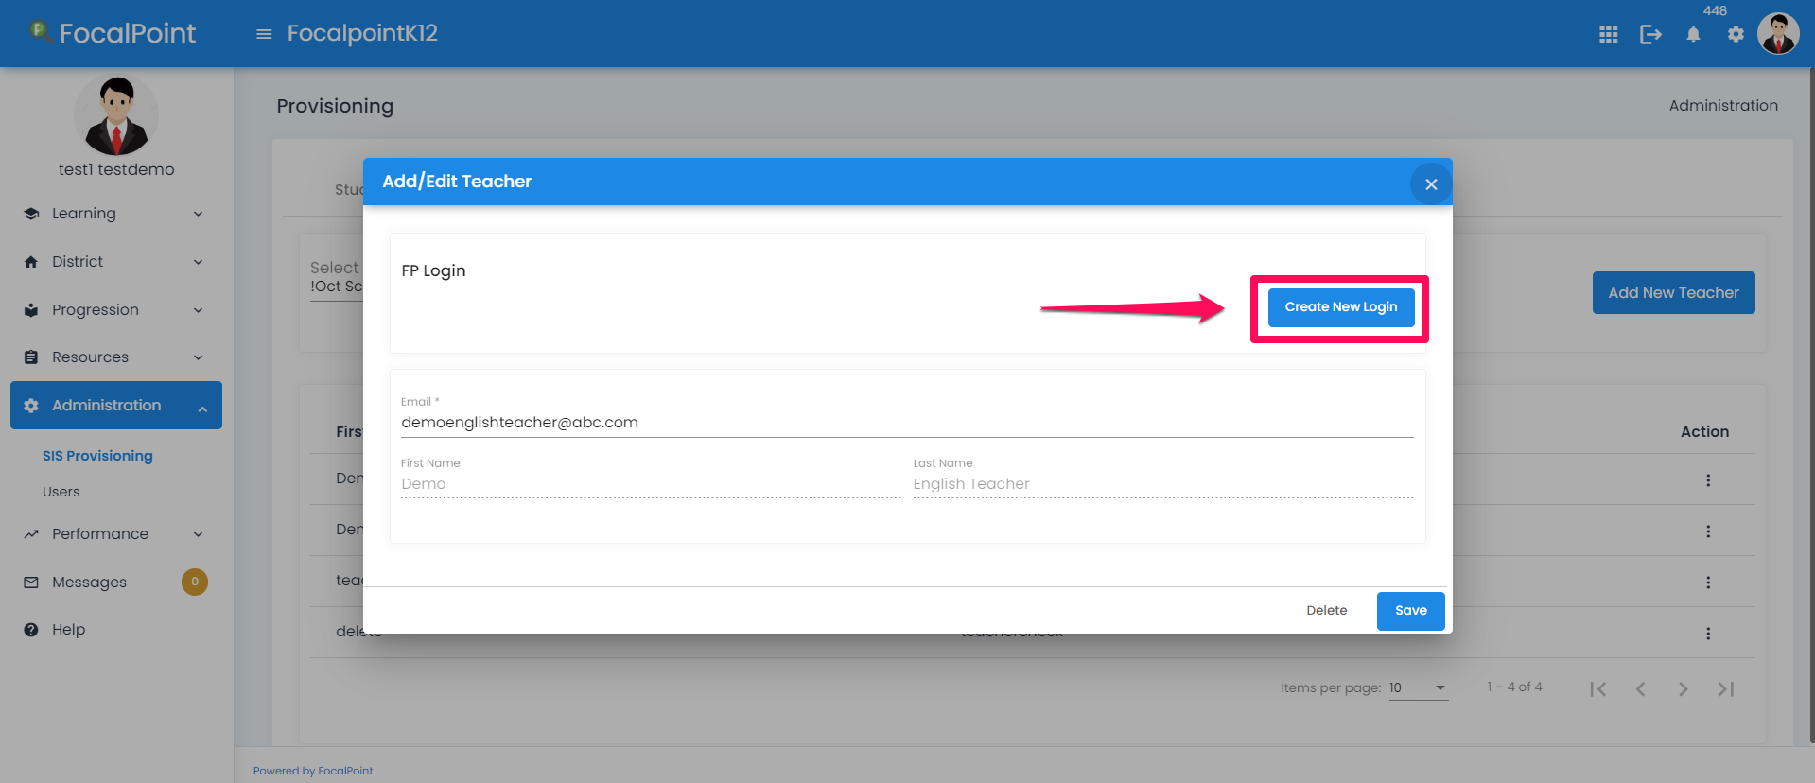
Create Login
Notes:
Click the Create New Login button to create the new log-in for the selected user and click ‘Save’. This will generate FP login for this user.
Note The user will receive an email with their login credentials. FocalPoint login for school admins or students can also be setup in the same way.

Slide 18
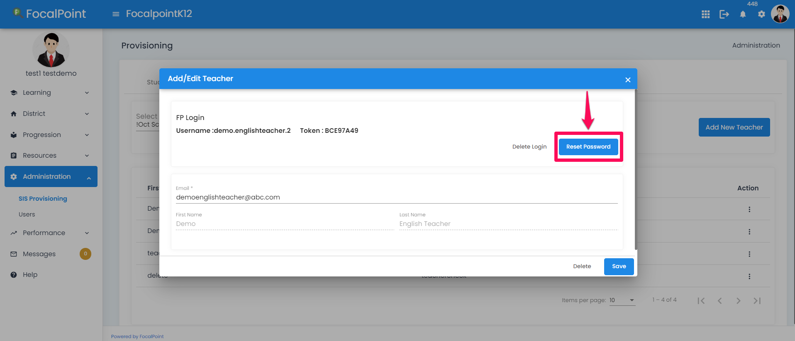
Reset Password
Notes:
This screen will show us that FocalPoint login is created for this teacher . Admin can reset the password for the user by clicking the Reset Password button
Then Click ‘Save’ . The Reset credentials are emailed to the users .

Slide 19
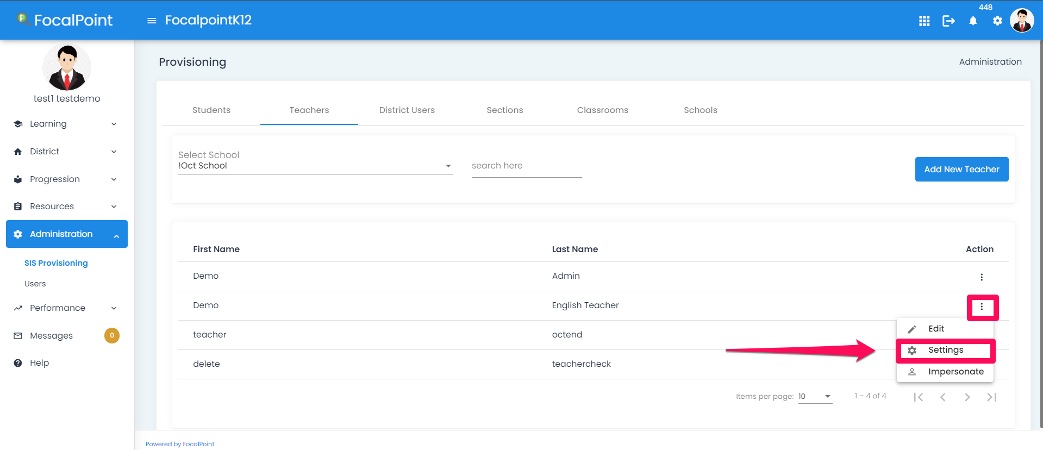
Associate Course and Classroom
Notes:
Once the teacher’s account is created, we associate Classroom and Course to a teacher . To do this, select the 3 dots against the Teacher and click on Settings.

Slide 20
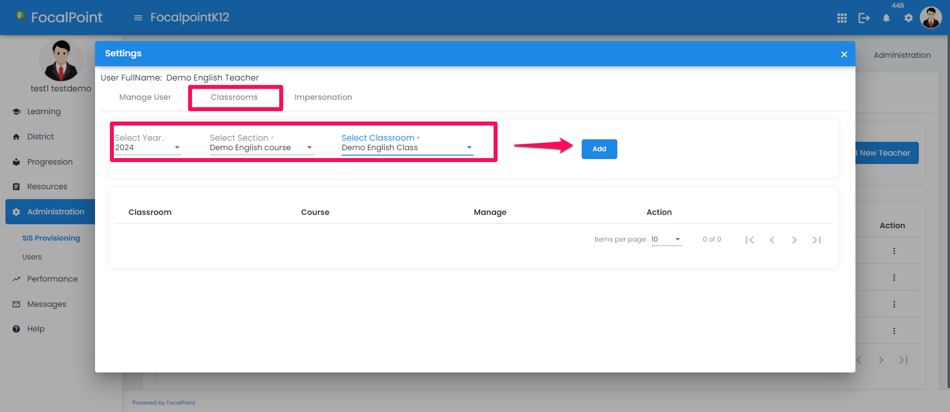
Add the Course and Classroom
Notes:
We select the section and classroom from the dropdown and then click on Add.

Slide 21
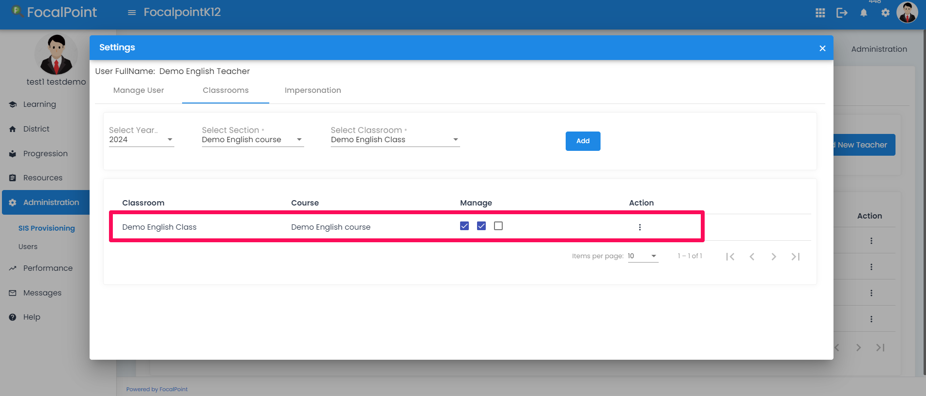
Classroom Assigned to Teacher
Notes:
The course and classroom will be added to the Teacher account. The classroom can be Managed with Assessments, Learning tree and Portfolio center (when you check the boxes under Manage tab) or Deleted (click on the 3 dots under Action tab and select Delete)
The teacher would see that classroom is associated to the course.
Note, this would mean that all the students who are associated to the classroom are now provisioned automatically to this course section with a teacher and corresponding course content.

Slide 22
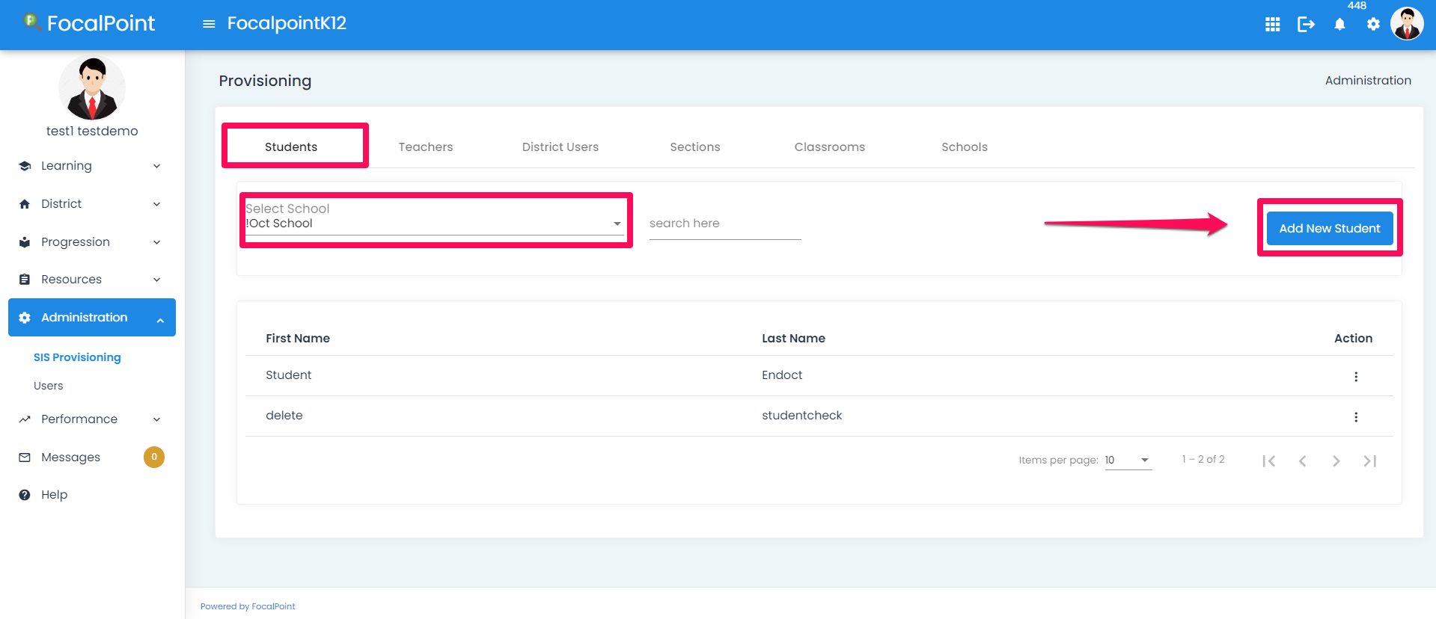
How to add Students?
Notes:
Now, lets take a look how to setup accounts for students.
Within the Student section, select the school and click Add New Student.

Slide 23
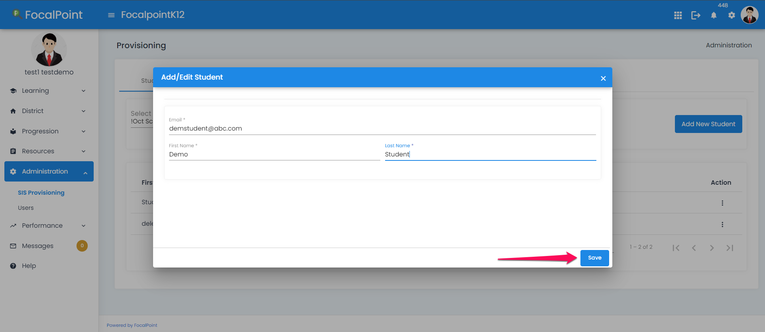
Add Student Details
Notes:
Then provide the details like First Name, Last Name and email address.
Click on Save.

Slide 24
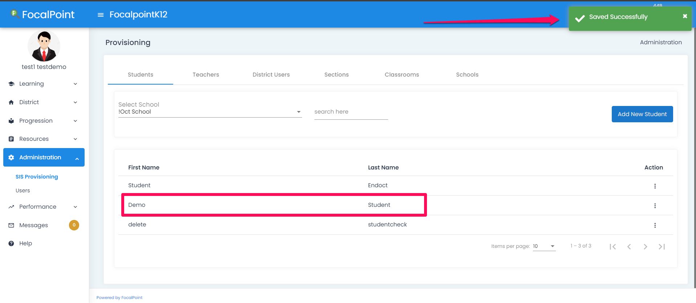
Student added to School
Notes:
The student would then be added to the school as shown here.

Slide 25
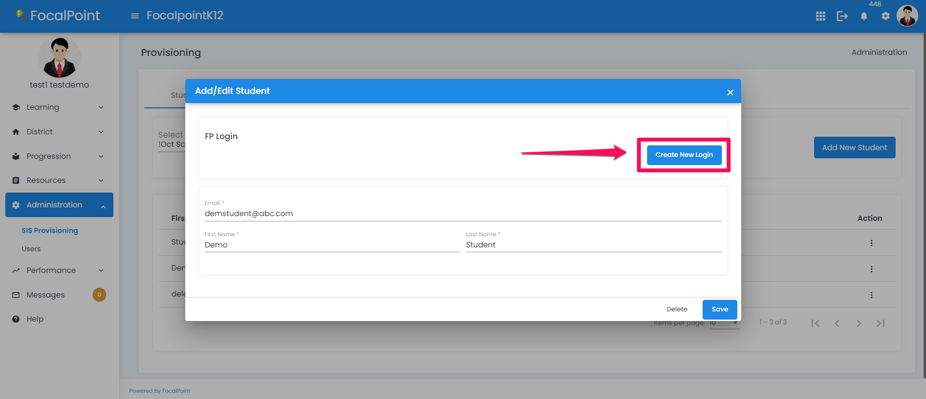
Create Login
Notes:
Select the 3 dots against the Student account, click on Edit. Then select Create Login.

Slide 26
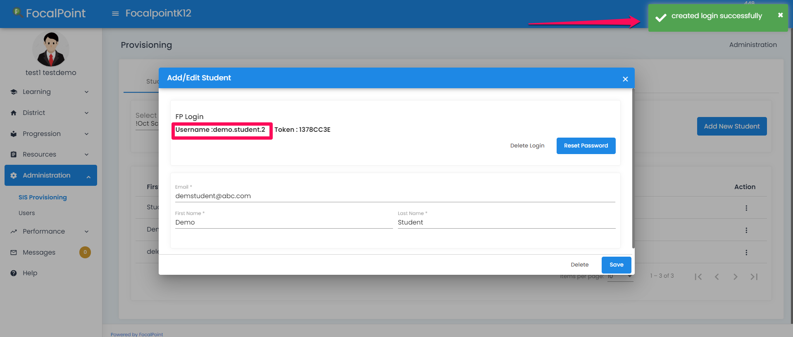
Login created
Notes:
Login will be created successfully.
Note: Currently we are not providing Token based logins.

Slide 27
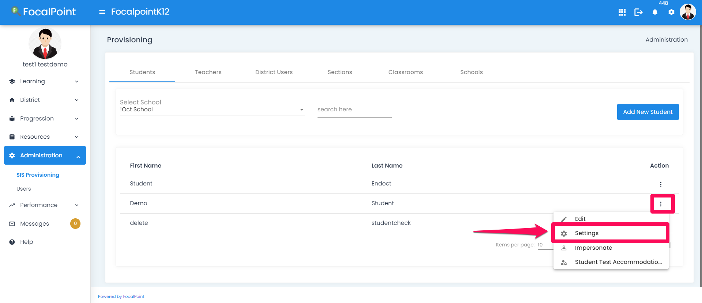
Assigning Classroom to Student
Notes:
Once the logins are setup for the student , we associate the Classroom to the student.
Select 3 dots against student account and click on Settings.

Slide 28
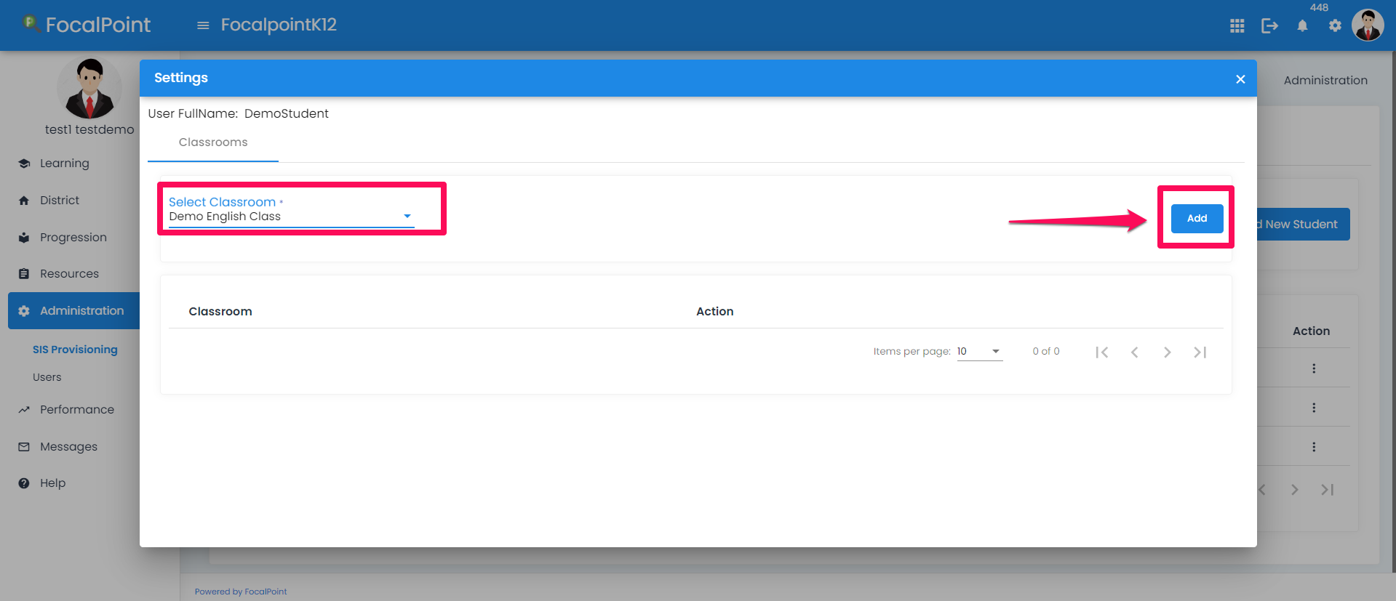
Add Classroom to Student
Notes:
Select the classroom and click on Add. The classroom will be assigned to the student.

Slide 29
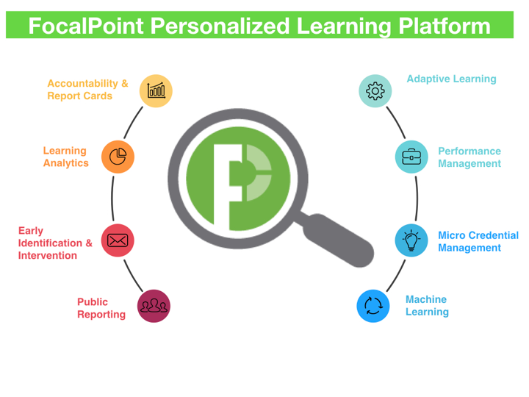
Thank you!
Notes:
Thank you!

